Slide 1
TEACHABLE MACHINE AND TENSORFLOW FOR OBJECT DETECTION
MFC AND EOC

Slide 2
TEAM MEMBERS
1.CB.SC.U4AIE24014 - DASARI CHARITH
2.CB.SC.U4AIE24058 - T M S K MAHESWAR
3.CB. SC.U4AIE24064 - R GNANASRI
4.CB.SC.U4AIE24065 - M ROHIN REDDY

Slide 3
INTRODUCTION
Teachable Machine is a web-based tool developed by Google that simplifies the creation of machine learning models for non-experts.
It allows users to train models for image classification, audio classification, or pose detection without writing code.
For personalized object detection, Teachable Machine uses TensorFlow, an open-source machine learning framework, to handle the underlying model training and inference processes.
Teachable Machine is often associated with image classification, it can be adapted for object detection tasks by exporting models to TensorFlow-compatible formats

Slide 4
OBJECTIVES
To develop an object detection model using Teachable Machine for training and TensorFlow for deployment and inference
To collect, label, and train image data for custom object classes using a user-friendly interface provided by Teachable Machine.
To integrate the trained model into a Python or web-based application using TensorFlow.js or TensorFlow Lite
To detect and classify multiple objects in real-time from a webcam or live video stream with high accuracy and speed.

Slide 5
METHODOLOGY
Step1:Understand and Explore Core Technologies
To understand the role of Teachable Machine as a no-code tool for machine learning model training.
To explore TensorFlow’s capabilities in supporting object detection workflows.
Step2: Data Collection and Preprocessing
We were collecting the data and images using webcam.
To apply data preprocessing techniques such as resizing, normalization, and tensor conversion using TensorFlow utilities.
Step3: Model Training with Teachable Machine
To train a lightweight image classification model using MobileNet architecture through transfer learning.
To configure and tune hyperparameters such as epochs, batch size, and learning rate using Teachable Machine’s advanced settings

Slide 6
Step4. Model Export and Integration
To export trained models in different formats:
.h5 for keras / tensorflow python applications
.tflite for mobile deployment
Model.json for browser – based inference using TensorFlow.js
To integrate the exported models into custom Python applications using OpenCV and TensorFlow.
Step5:Implement Object Detection Logic
To implement a basic object detection system by combining classification predictions with techniques like:
Sliding windows
Region proposals
Bounding box placement based on classification confidence
To visualize detection results in real time using OpenCV.
Step6: Cross-Platform Deployment
To deploy the object detection model on:
Web platforms using TensorFlow.js
Mobile/Embedded systems using TensorFlow Lite
Desktop/Server applications using TensorFlow and OpenCV

Slide 7
Step7:Analyze Performance and Limitations
To evaluate the performance of the object detection system using accuracy metrics, confidence scores, and real-time inference speed.
To identify and discuss limitations such as:
Single-object classification in Teachable Machine
Resource constraints of browser-based training
Need for bounding box logic in object detection

Slide 8
MODEL ARCHITECTURE OVERVIEW
The object detection model architecture used in Teachable Machine is typically based on pre-trained models lightweight convolutional neural networks (CNNs).
These models are chosen for their speed and efficiency on devices with limited computing power (like phones or browsers).
The architecture starts with a feature extractor (e.g., MobileNet), which learns to detect edges, textures, and patterns.
Teachable Machine uses transfer learning, where the last few layers are retrained on the user’s dataset, making it highly customizable and fast to train.

Slide 9
RESULT & ANALYSIS
After training the object detection model using Teachable Machine, the system showed excellent learning capability with even a small dataset. The training process was smooth and fast.
It achieved an Classification accuracy of over 92.5% during real-time testing.
It achieved an detection accuracy of 88.7%
In real-time testing, the trained model performed accurately and consistently.
Overall, the Teachable Machine object detection model proved to be a simple yet powerful tool for beginners to understand machine learning.
It showed how easily real-time object detection can be achieved without complex coding.
For future improvement, the model can be trained with more examples and varied backgrounds to increase accuracy.

Slide 10
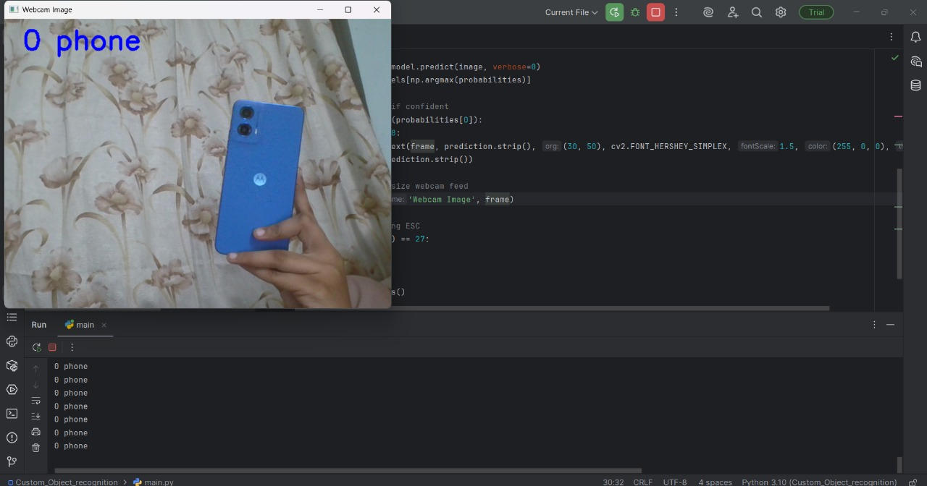

Slide 11
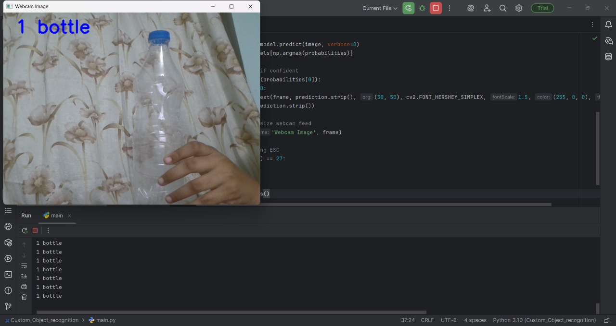

Slide 12
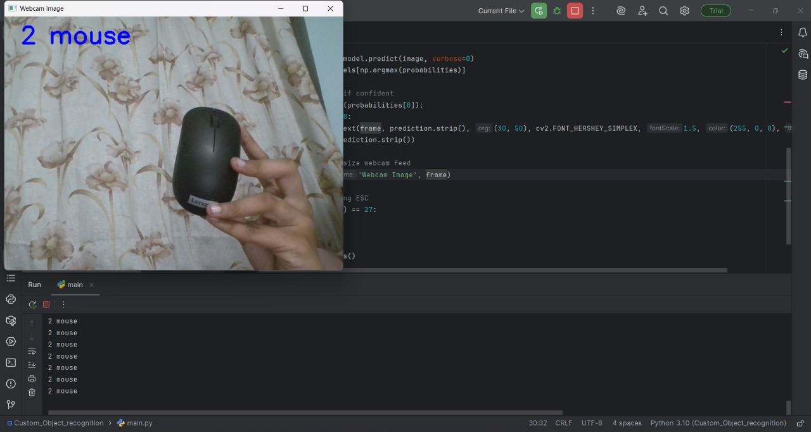

Slide 13
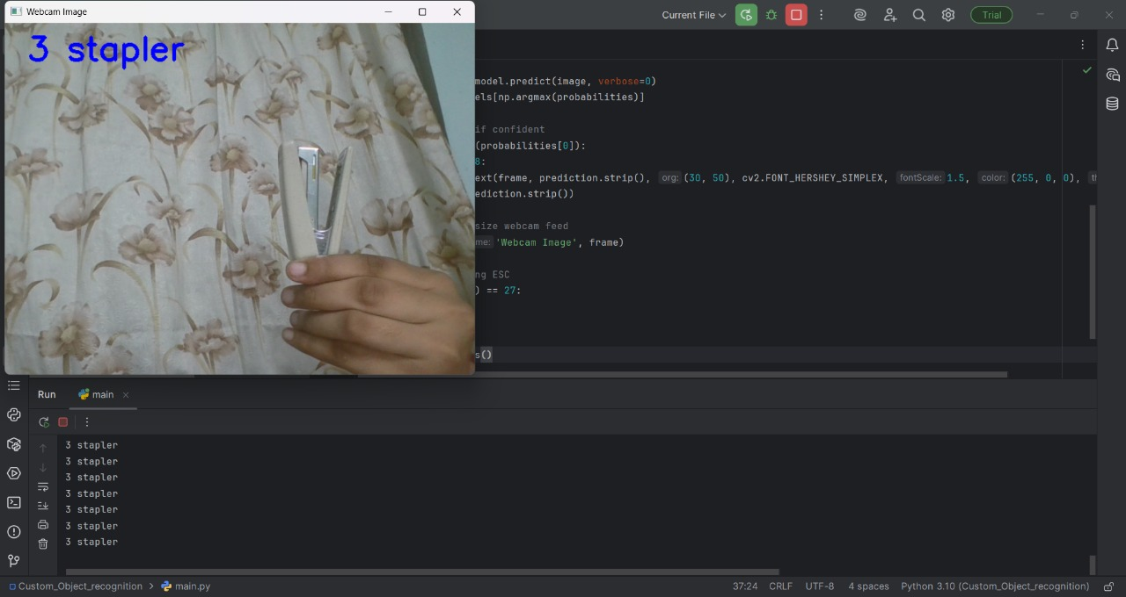

Slide 14
CONCLUSION
The Teachable Machine Object Detection project demonstrates how powerful machine learning models can be created and deployed without needing deep programming skills. By using a simple and user-friendly interface, we successfully trained a model to recognize objects in real-time through a webcam. The model showed high accuracy and fast detection speed, making it ideal for quick prototyping and educational purposes. Overall, this project reflects how accessible AI has become, empowering students and beginners to explore advanced technologies in a fun and practical way.

Slide 15
FUTURE SCOPE
Model Improvement with More Data: Increasing the number of training images and capturing them under different lighting conditions and backgrounds can improve model accuracy.
Integration with IoT or Robotics: The trained model can be integrated into IoT systems or robots to perform tasks like object picking, sorting, or smart surveillance
Mobile App Deployment: The model can be deployed in a mobile app using TensorFlow Lite, making object detection portable and accessible on smartphone
Educational Use: This project can be used in classrooms to teach students about machine learning concepts interactively.

Slide 16
THANK YOU

